Slide 1
Overcoming
Impostor Syndrome
-> based on the Ada Initiative workshop http://adainitiative.org CC BY-SA <-
@TimeaTurdean @WTMVIE

Slide 2
Format of the workshop
15 min: Introduction & co.
25 min: Going through the slides
15 min: “Take a compliment” exercise
15 min: Values exercise
15 min: Combating negative thoughts exercise
05 min: Wrap-up

Slide 3


Is this you, while searching for a job?

Slide 4
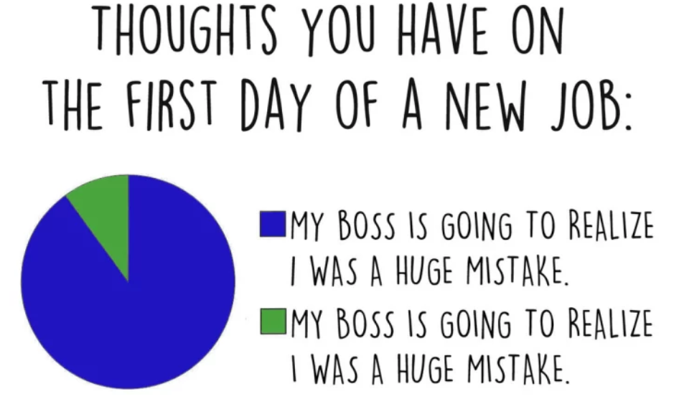
Is this you, when you get the job?

Slide 5
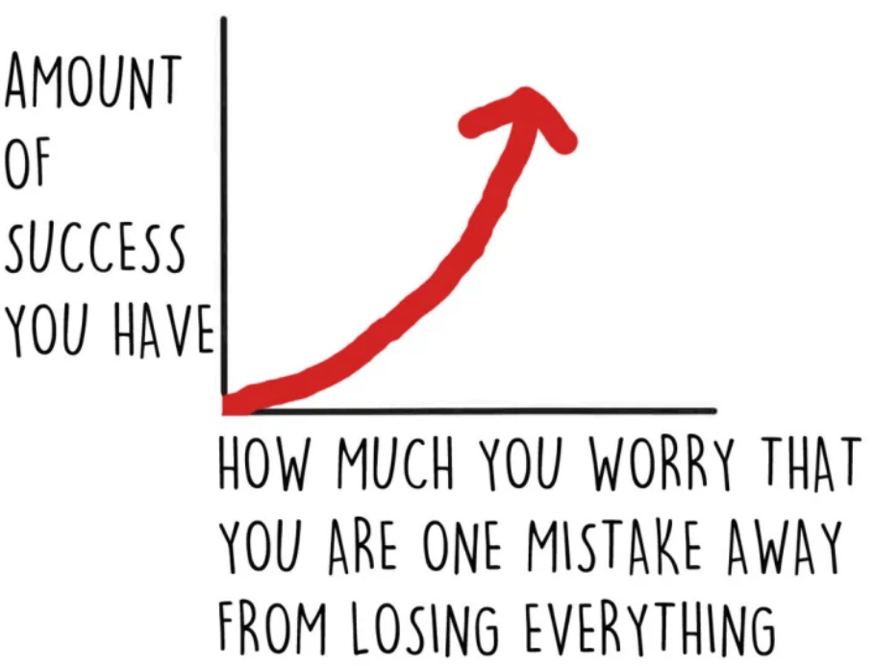
Is this you on the job?

Slide 6
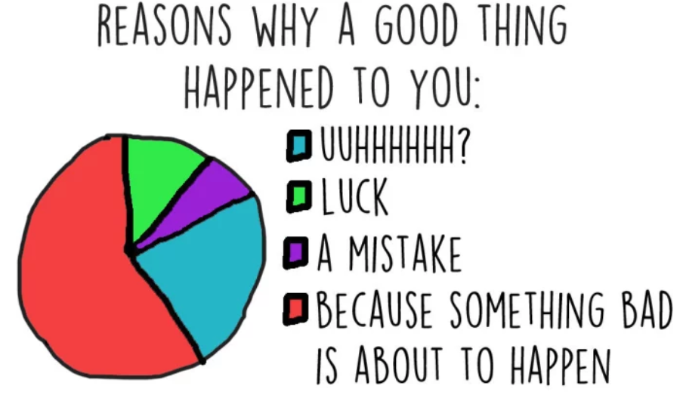
Is this you?

Slide 7
Impostor Syndrome
The feeling that you are a fraud or unqualified for the work you are already doing - faking it - and may be found out at any moment.

Slide 8
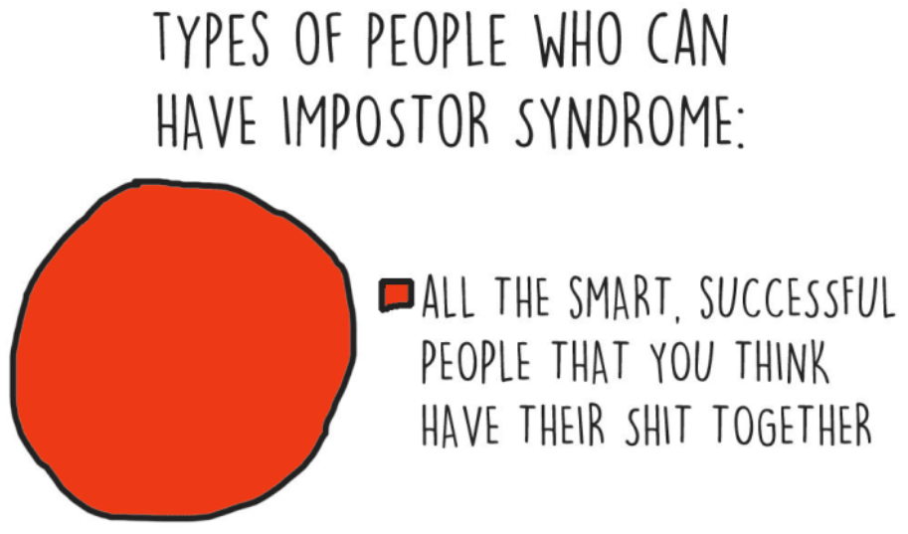

Slide 9
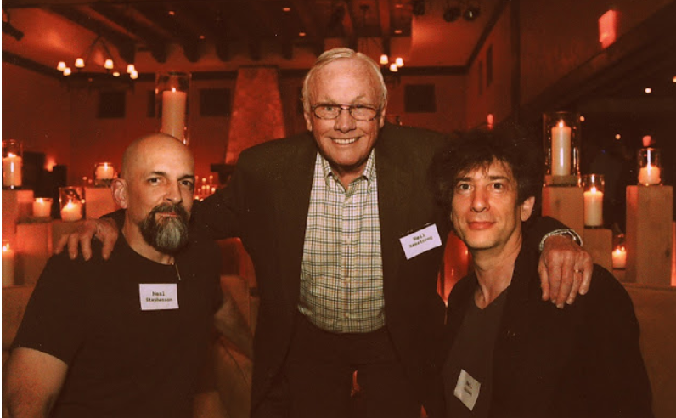
Neil Gaiman on Impostor Syndrome: http://neil-gaiman.tumblr.com/post/160603396711/hi-i-read-that-youve-dealt-with-with-impostor

Slide 10

WHY?

Slide 11
“Did you get invited to the event just for the diversity quota?”

Slide 12
“You don’t know what you are talking about, you are not a backend programmer.”

Slide 13
“Did you come to the event because you accompany your wife?”

Slide 14
Why do you feel like an impostor
Sexism says women can't be good at what it is you are doing
People forget facts that don't fit their stereotypes (“prove-it-again bias”)
People act surprised when you are good
People advise you to lower your ambitions
People tell you that you are an impostor

Slide 15
Why do you feel like an impostor
People treat you like an impostor

Slide 16
What is the result
We have less satisfaction in our lives
We waste time over-preparing and worrying instead of doing good work and having fun
We are less effective as colleagues
We ask for less money
We don't ask for challenges
We don't ask for promotions or apply for jobs

Slide 17
What is the result
You doubt yourself, you are less confident

Slide 18
Overcoming Impostor Syndrome
Talk about it and share your own failures
Watch your self-diminishing language
Teach others what you know
Ask questions
Perspective check from a friend
List your accomplishments and own them
Practice accepting compliments
Talk to your colleagues and get the perspective of what is going on in the community/workplace
Notes:
Before I begin, I just have a few handouts for you
“I think”, “I believe”, and “I feel”, for stronger options such as “I’m confident”, “I’m convinced”, “I expect”

Slide 19


Slide 20



Exercises
Take a compliment
Value exercise
Combating negative thoughts

Slide 21
About the exercises
Do exercises with your group
No one has to participate
No one has to report out
You can leave, switch tables, or come back at any time for any reason

Slide 22

Take a compliment
Examples:
“You are a good listener.“
“You work hard.“
“You did really great in the meeting.“
“I liked your input earlier, it gave us some good ideas.“
“Great idea in solving the bug.“

Slide 23
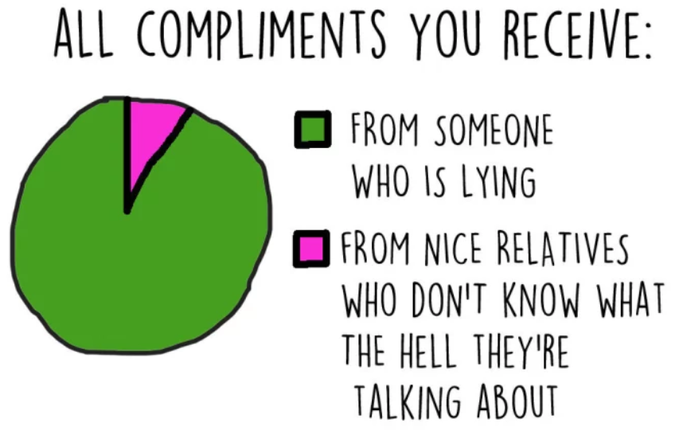

Slide 24

Value exercise
Take your handouts and complete the exercise.
At the end each group can voluntarily report on the results.

Slide 25

Combating negative thoughts
Take your handouts and work on the last
exercise:
“Thoughts record.“

Slide 26
Denise Paolucci: “Overcoming Impostor Syndrome” (linux.conf.au 2013)
Julie Pagano: “It's Dangerous to Go Alone” (PyCon 2014)
Mood Gym: https://moodgym.anu.edu.au/welcome
Slides, handout, guide for this workshop: http://adainitiative.org/continue-our-work/impostor-syndrome-training/
Charts from BuzzFeed: https://www.buzzfeed.com/kristinchirico/13-charts-that-will-make-total-sense-to-people-with-impostor?utm_term=.sfro3oD0#.gj06P6DX

Slide 27


See you at the next WTM event!

